Slide 1
Common-Mode fundamentals for Shipboard Power Systems Part 1
Dr. Norbert Doerry Dr. John Amy
http://doerry.org/norbert/MarineElectricalPowerSystems/index.htm
© 2025 by Norbert Doerry and John Amy This work is licensed via: CC BY 4.0 (https://creativecommons.org/)

Slide 2
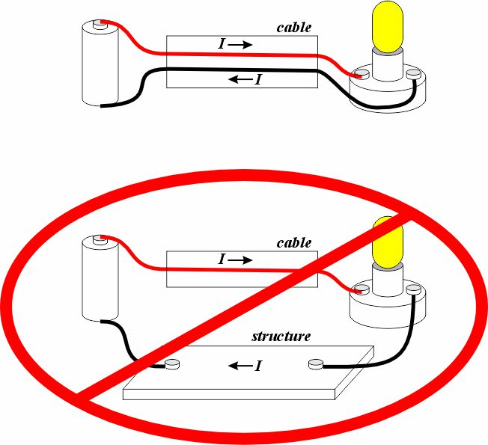
Shipboard power systems are designed for the “Differential Mode”
Power is distributed via a set of conductors
The current going to a load or another power system component is intended to return via the same set of conductors.
Unlike automobiles which use structure as a current return path.
The sum of the current flowing in the same direction through the set of conductors is intended to equal zero.

Slide 3
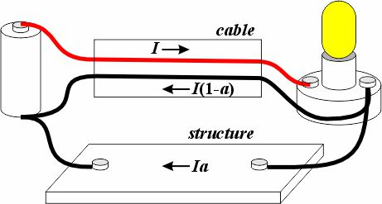
“Common Mode” is usually undesirable
Common Mode (CM) current is the sum of the current flowing in the same direction through a set of conductors.
Measured instantaneously, then summed.
A CM current implies the “return current” is flowing through an unintended route.
Can be through the hull
Can be through other power system conductors
Common Mode current is generally not desirable.
Hull Currents
EMI
Maloperation of sensors and protective devices
Excessive heating of filters and other components
Common Mode current route often not predictable

Slide 4
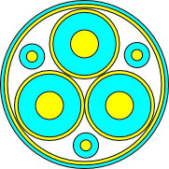
Common Mode current paths
AC power components typically have parasitic capacitances.
Cable conductors and their grounded shields / drain wires
Cable conductors and ship structure
Transformer / generator / motor winding to winding capacitance
Transformer / generator / motor winding to ground capacitance
Grounding system may also provide a path for currents through the ship structure.
Solidly Grounded
High Resistance Grounded Systems
System configurations can provide multiple current paths.
Ring bus
Multiple auctioneering diode connected loads in dc systems

Slide 5
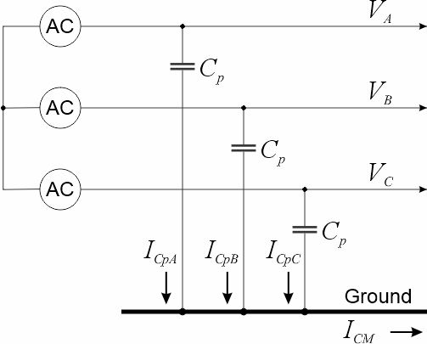


Three Phase Parasitic Capacitance
The Neutral Voltage is also called a Common Mode Voltage
The Neutral Voltage (V_{N}) of a set conductors is the average value of the conductor voltages with respect to a reference voltage (such as ground).
$$V_{N}=\frac{1}{3}\left(V_{A}+V_{B}+V_{C}\right)$$
$$V_{A}=V_{N}+V_{AN}$$
$$V_{B}=V_{N}+V_{BN}$$
$$V_{C}=V_{N}+V_{CN}$$
$$V_{N}=\frac{1}{3}\left(V_{N}+V_{AN}+V_{N}+V_{BN}+V_{N}+V_{CN} \right)$$
$$V_{AN}+V_{BN}+V_{CN}=0$$
$$I_{CpA}=C_{p}\left(\frac{dV_{N}}{dt}+\frac{dV_{AN}}{dt}\right)$$
$$I_{CpB}=C_{p}\left(\frac{dV_{N}}{dt}+\frac{dV_{BN}}{dt}\right)$$
$$I_{CpC}=C_{p}\left(\frac{dV_{N}}{dt}+\frac{dV_{CN}}{dt}\right)$$
$$I_{CM}=I_{CpA}+ I_{CpB}+I_{CpC}$$
$$I_{CM}={3C}_{p}\left(\frac{dV_{N}}{dt}\right)+C_{p}\left(\frac{d\left(V_{AN}+V_{BN}+V_{CN}\right)}{dt}\right)$$
Common Mode Current only Depends on the Neutral Voltage and parasitic capacitance
$$I_{CM}={3C}_{p}\left(\frac{dV_{N}}{dt}\right)$$

Slide 6
Common Mode Voltage properties
Common mode voltage (neutral voltage) is a property of a set of conductors.
Measured with respect to a specified reference potential (such as ground or another neutral).
Each conductor voltage is measured instantaneously, then averaged across conductors.
Generally, cannot measure it directly in a circuit, must calculate it from measurements on each of the conductors.
A conductor labeled as a Neutral may or may not be at the neutral voltage (common mode voltage) .
No common mode current can flow from the set of parasitic capacitances if a common mode voltage with respect to ground is not present on the conductors.

Slide 7
Common Mode Current Properties
Common mode currents are usually orders of magnitude less than the desired differential mode currents.
Balanced loads connected only between phases and without connections to ground do not contribute to common mode currents (Kirchhoff’s current law prevents this).
Can be delta or wye (with wye-point unterminated)
Balanced sources connected only between phases and without connections to ground do not contribute to common mode currents (Kirchhoff’s current law prevents this).
Can be delta or wye (with wye-point unterminated)
Series impedances (resistance, inductance, capacitance) impact common mode currents.

Slide 8
Wrap up

